Slide 1
Accessible Signage on Public Transit
Office of Civil Rights Racial Equity and Inclusion

Slide 2
In Los Angeles, accessible public transit signage must comply with several standards, primarily guided by the Americans with Disabilities Act (ADA), California Building Code, the Manual on Uniform Traffic Control Devices (MUTCD), and LA Metro’s own design standards.

Slide 3
Americans with Disabilities Act Requirements
The Americans with Disabilities Act provides requirements for signage which includes guidance for the following elements:
Tactile text
Visual Requirements
Permanent Room Identifiers
Directional and Informational signs
Required Accessibility Symbols
Visual and Tactile elements
Means of egress signs
Elevator signs and labels
Braille
Installation Height
Contrast
February 2025

Slide 4

Tactile Text Requirements
Tactile Requirements apply to these types of signs:
Interior and exterior signs identifying permanent rooms and spaces, where provided
required door labels at exit stairways, exit passageways, and exit discharge
required labels for floor levels, car controls, and emergency communication devices at elevators
rail station identification signs at entrances and platforms or boarding areas
February 2025

Slide 5
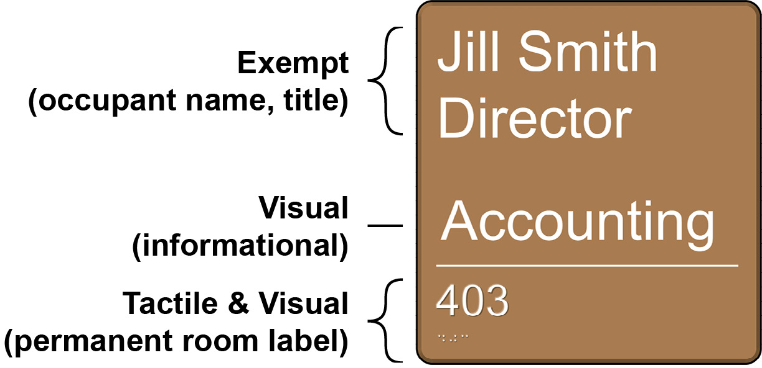
Tactile Text Requirements
Tactile signs must have raised characters that are repeated in Grade 2 braille. In addition, they are subject to requirements for non-glare finish and color contrast for visual accessibility. Other information provided in addition to permanent room or space labels is not required to be raised or brailled but must meet visual criteria if informational or directional. Some information on such signs may be exempt, such as occupant names.
This sign includes exempt and informational content in addition to a permanent room label (room number).
February 2025

Slide 6
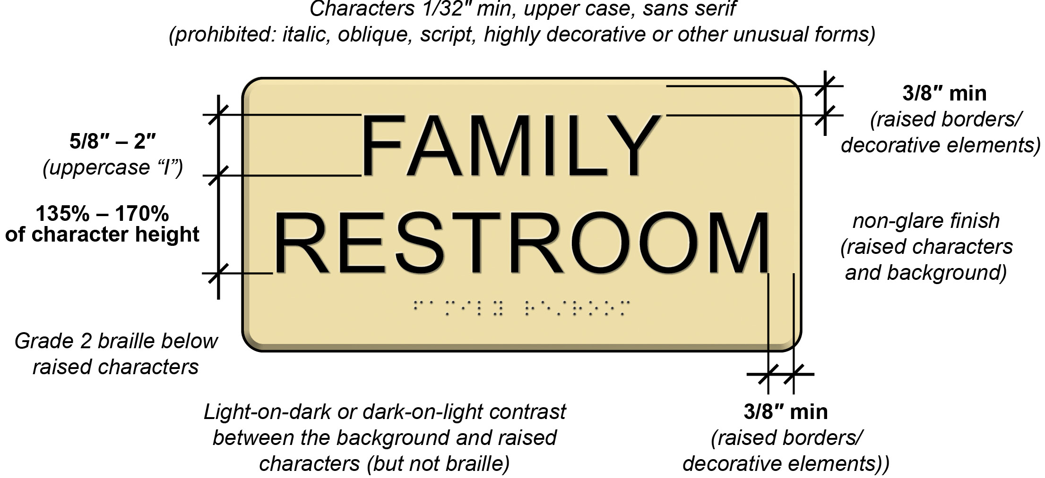
Technical Requirements for Tactile Characters
February 2025

Slide 7

Technical Requirements for Tactile Characters
Character spacing, as measured between the two closest points of adjacent characters excluding word spaces, is specified for rectangular and non-rectangular cross sections.
February 2025

Slide 8
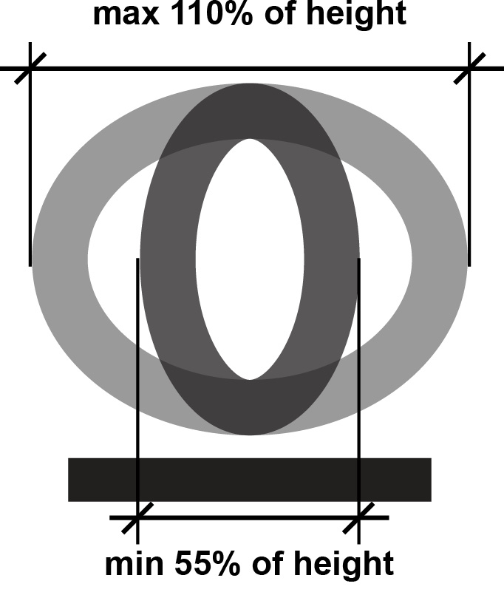
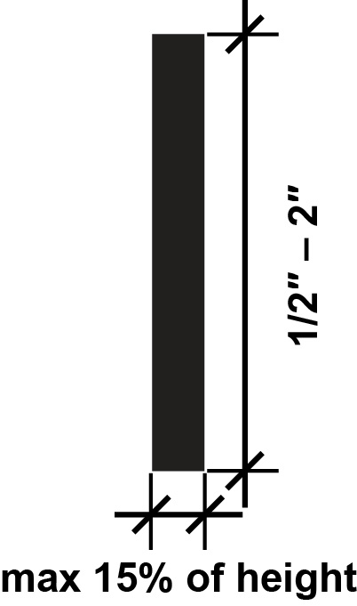
Technical Requirements for Tactile Characters
The stroke thickness of the uppercase letter “I” must be 15% maximum of the character height. Characters must be selected from fonts where the width of the uppercase letter “O” is 55% to 110% of the height of the uppercase letter “I.” Raised character height must be from 1/2 inch minimum to 2 inches maximum. Where raised characters also serve as visual characters, the minimum height is 5/8 inch.
February 2025

Slide 9
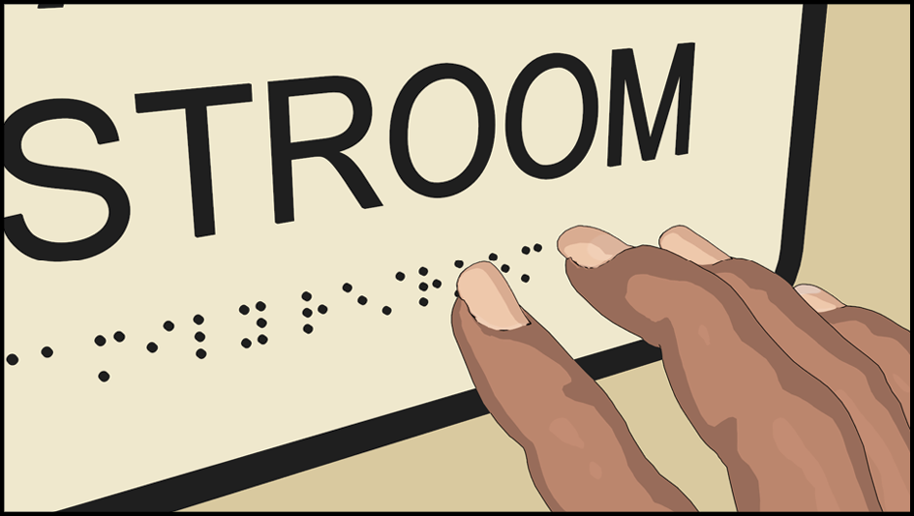

Braille
The content of raised characters also must be provided in contracted or “Grade 2” braille. This type of braille uses the same characters as standard braille but also includes characters to represent common words and letter combinations. Braille is read with a light sweeping touch, and braille dots must be domed or rounded. The Standards specify the height and diameter of dots and their spacing within and between cells.
Braille located below entire raised text and separated ⅜ inch minimum from tactile characters and any raised borders and decorative elements.
February 2025

Slide 10
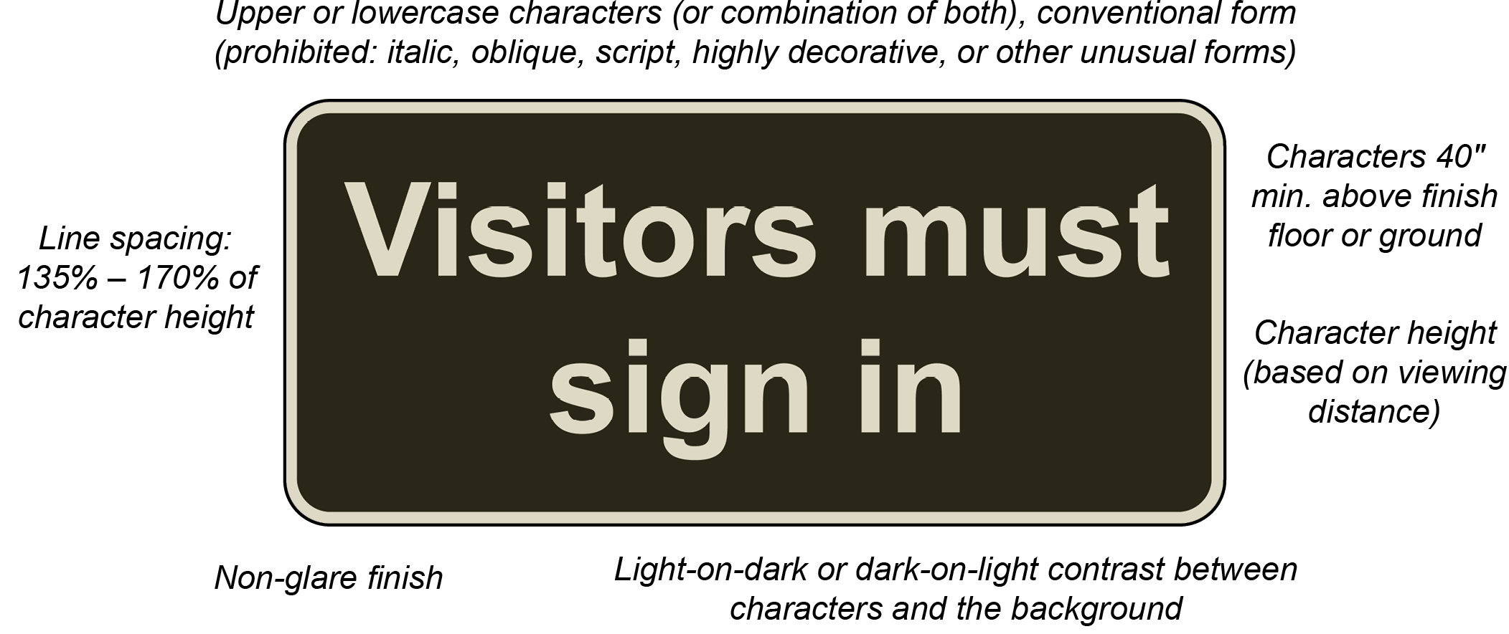
Technical Requirements for Characters
Specifications for visual characters cover finish and contrast, case, style, character proportion and height, stroke thickness, and line and character spacing
February 2025

Slide 11




Technical Requirements for Characters
Characters must contrast with their background with either light-on-dark or dark-on-light and have a non-glare finish. A minimum level of contrast is not specified in the Standards. The higher the contrast, the better for legibility, particularly for people with low vision. Variated or textured backgrounds can reduce contrast and compromise readability.
February 2025
Good Contrast
Bad Contrast

Slide 12
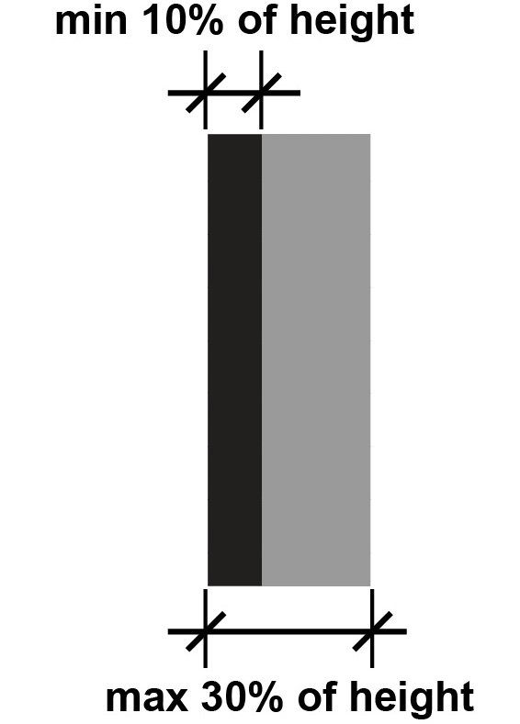
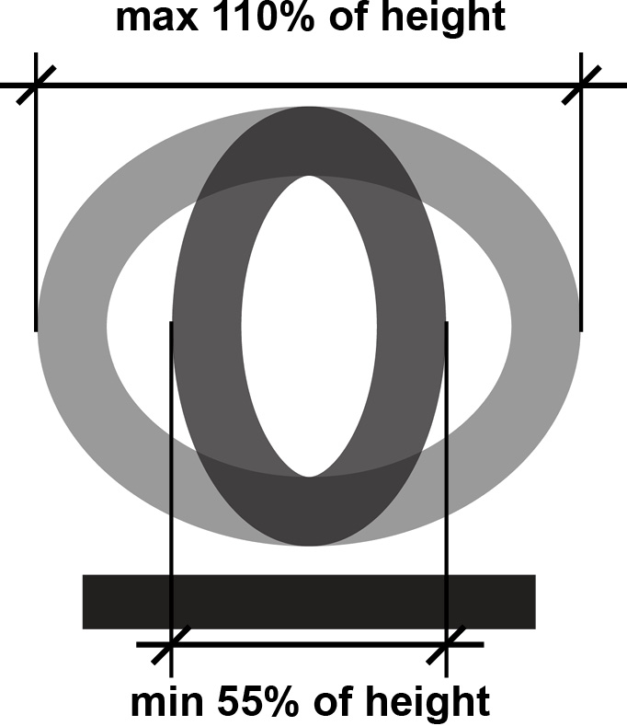
Technical Requirements for Characters
The stroke thickness of the uppercase letter “I” must be from 10% to 30% of the character height. Characters must be selected from fonts where the width of the uppercase letter “O” is 55% to 110% of the height of the uppercase letter “I.”
February 2025

Slide 13
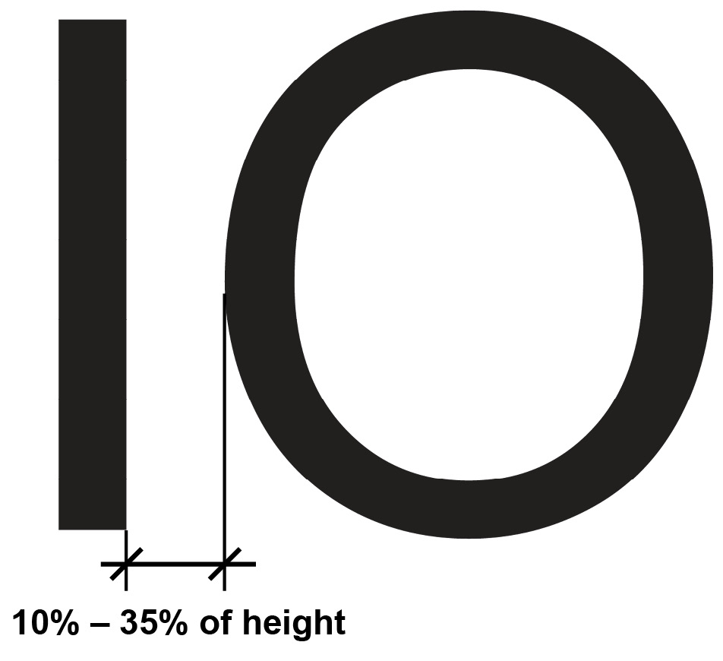
Character Spacing
The stroke thickness of the uppercase letter “I” must be from 10% to 30% of the character height. Characters must be selected from fonts where the width of the uppercase letter “O” is 55% to 110% of the height of the uppercase letter “I.”
February 2025

Slide 14
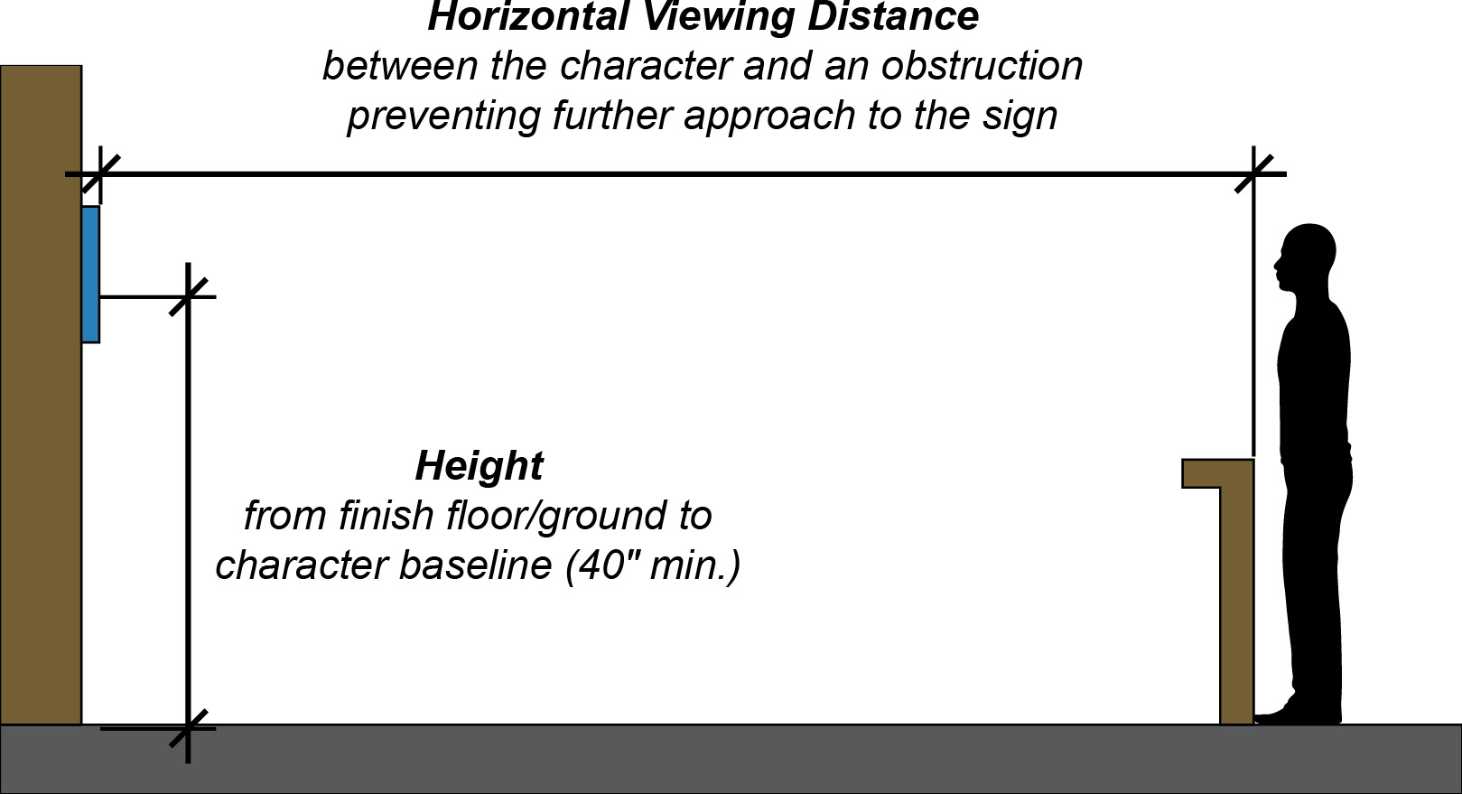
Character Height
The minimum height of characters is based on their height above the finish floor and the horizontal viewing distance. Horizontal viewing distance is the distance between the character and an obstruction preventing further approach to the sign.
February 2025

Slide 15
Character Height
The minimum height of characters is based on their height above the finish floor and the horizontal viewing distance. Horizontal viewing distance is the distance between the character and an obstruction preventing further approach to the sign.
Height | Viewing Distance | Min. Character Height
40″ – 70″ | under 6′ | 5/8″
 | 6′ or more | 5/8″ + 1/8″ per foot of viewing distance above 6’
above 70″ to 10′ | under 15′ | 2″
 | 15′ or more | 2″ + 1/8″ per foot of viewing distance above 15′
above 10′ | under 21′ | 3″
 | 21′ or more | 3″ + 1/8″ per foot of viewing distance above 21′
February 2025

Slide 16
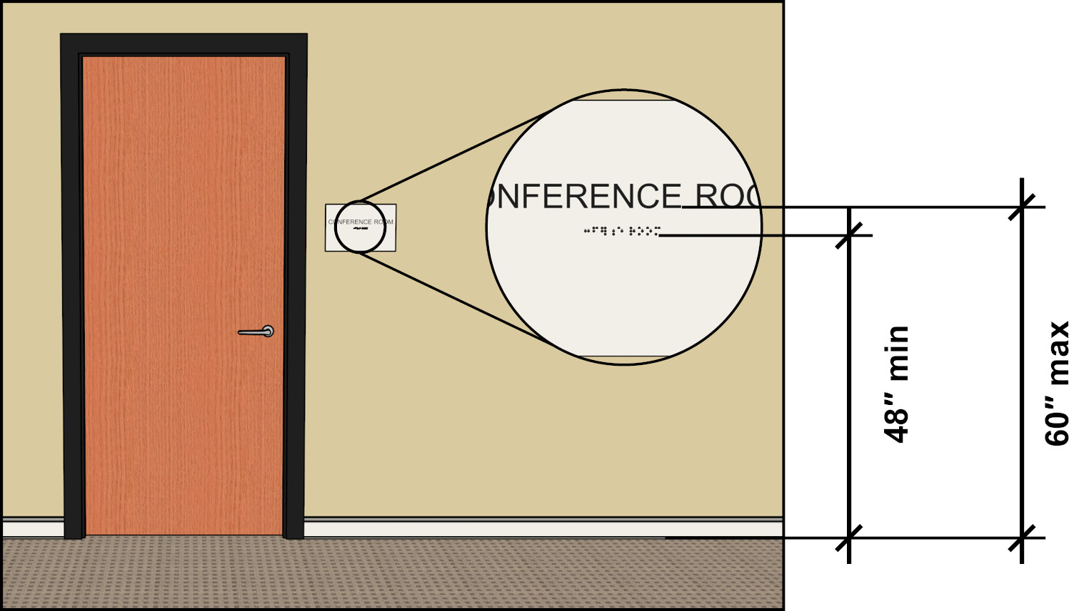
Installation Height and Location
Raised characters and braille on signs must be located 48 inches minimum above the finish floor or ground surface, measured from the baseline of the lowest tactile character, and 60 inches maximum above the finish floor or ground surface, measured from the baseline of the highest tactile character. This location is convenient for tactile reading.
February 2025

Slide 17
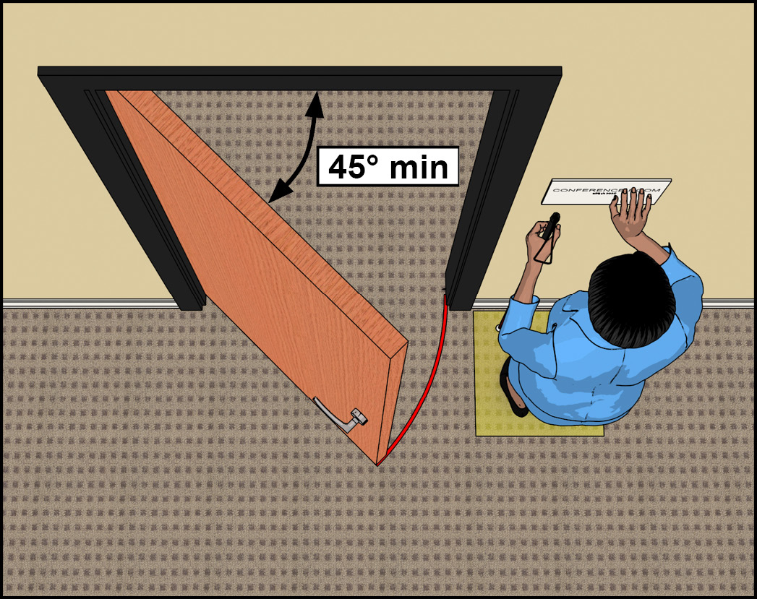
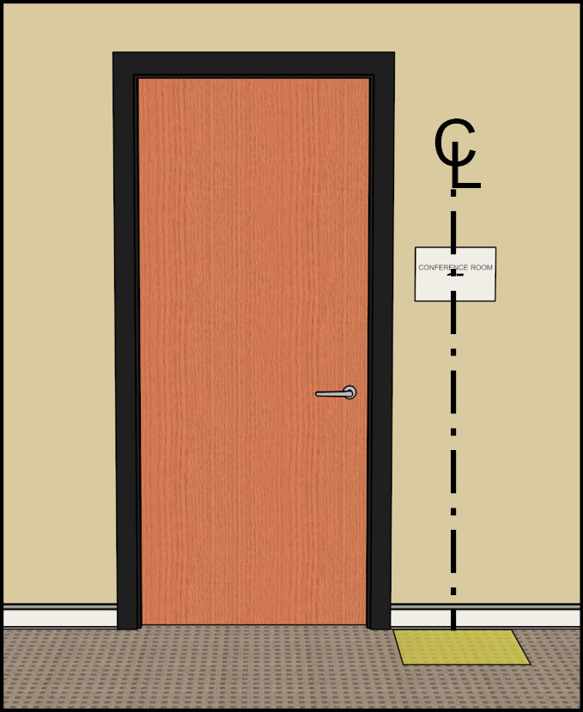
Installation Height and Location
A clear floor space 18 inches minimum by 18 inches minimum must be centered on the tactile characters. This placement of the clear floor space provides unobstructed standing space at the sign for reading by touch. This space must be free of any protrusions to a height of 80 inches. For safety, the space must be located beyond the arc of any door swing to a 45° open position. This effectively sets a minimum, but not an absolute, distance of tactile signs from out-swinging doors. While the clear floor space must be centered on the tactile characters, signs can be located varying distances beyond the door swing.
This clear floor space must be beyond the swing of any door from a closed position to a 45° open position.
February 2025
18″ x 18″ clear floor space centered on tactile characters

Slide 18


Location at Doors
At single doors, tactile signs must be located alongside the door on the latch side. They are permitted on the push side of doors equipped with closers that do not have devices to keep them open.
18″ x 18″ clear floor space centered on tactile characters
Sign on push side of a door with a closer.
February 2025

Slide 19


Location at Doors
If there is no wall space on the latch side, signs must be located on the nearest adjacent wall.
Recessed door with sign on adjacent wall.
Recessed door with space for latch side placement.
February 2025

Slide 20


Location at Doors
For double-leaf doors with one active leaf, the sign must be located on the inactive leaf. If each door has an active leaf, the sign must be located to the right of the door.
Sign at right-side hinge side of double-door entry with two active leaves.
Sign on inactive leaf at double-door entry.
February 2025

Slide 21
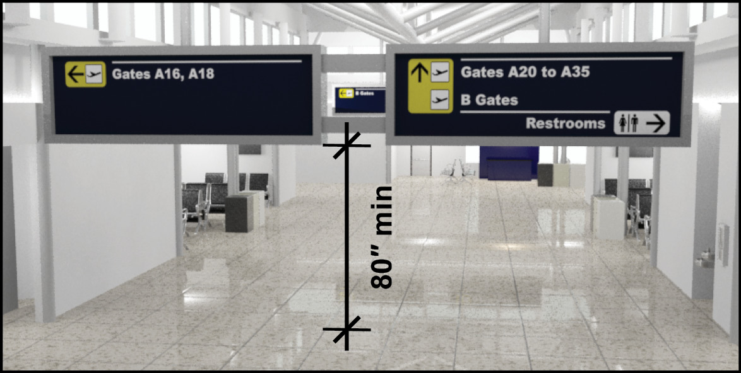
Headroom Clearance at Overhead Signs
Signs above circulation paths must provide the required 80 inches minimum headroom clearance
February 2025

Slide 22
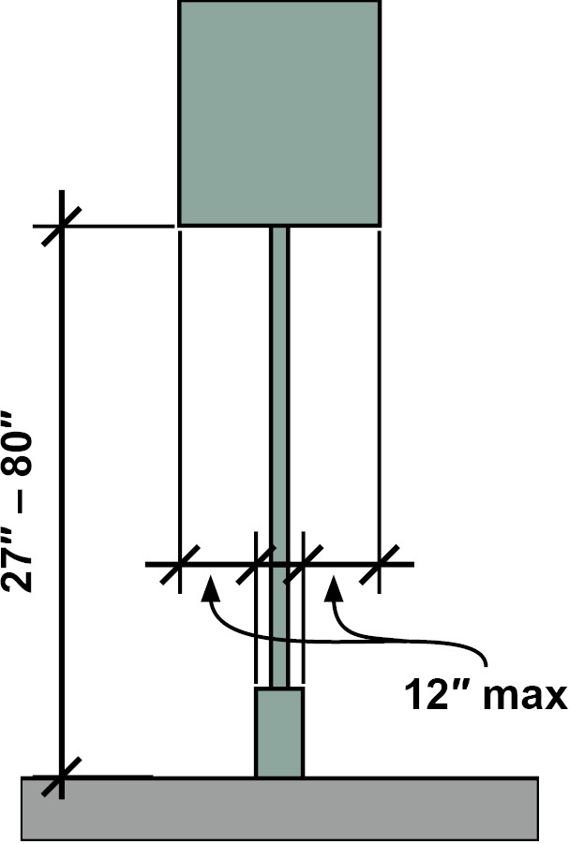
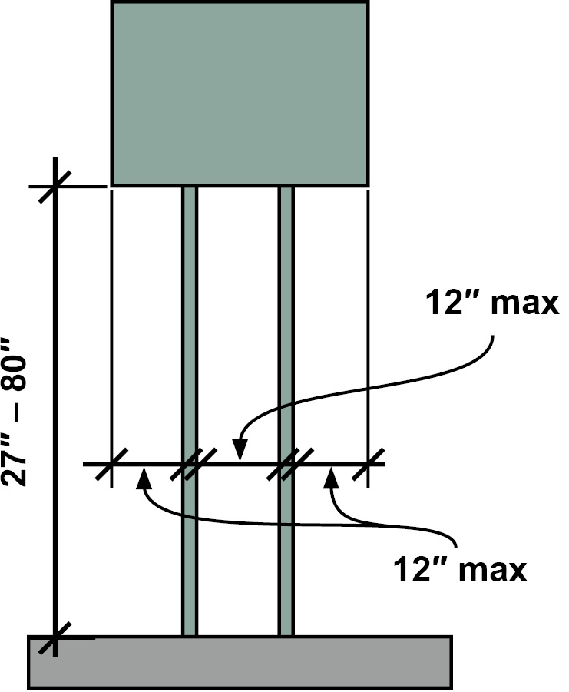
Post-Mounted Signs
Signs and other objects mounted on posts or pylons that have leading edges of 27 inches to 80 inches high cannot protrude more than 12 inches into circulation paths. The 12-inch limit also applies to the clearance between multiple posts, excluding the sloping portions of handrails.
February 2025

Slide 23
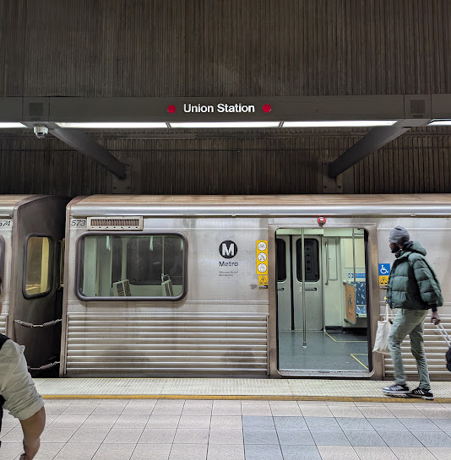
Station Names
The Standards also require the provision of signs labelling stations that meet the visual requirements (§703.5). These signs must be clearly visible from within vehicles on both sides (when not obstructed by another vehicle) and within passenger sight lines.
February 2025

Slide 24
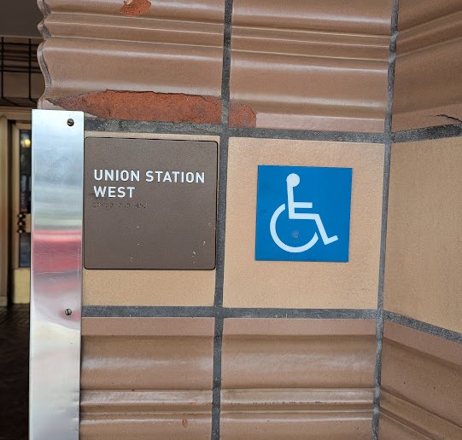
Entrances
If signs are provided to identify the rail stations or station entrances, a tactile sign (§703.2) providing this information is required at each entrance. The tactile signs must be placed in uniform locations to the maximum extent feasible. If a station lacks a defined entrance, at least one tactile sign must be provided in a central location. In other facilities, exterior signs not located at the entrance or door they serve are not required to be tactile.
February 2025

Slide 25
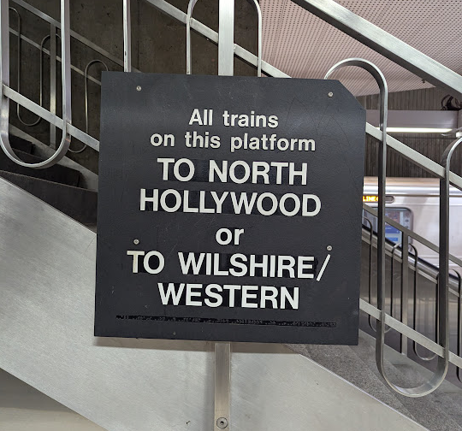
Platform or Boarding Area Signs
In addition, at least one tactile station identification sign is required on each platform or boarding area. Requirements for visual characters apply to signs at boarding areas, platforms, or mezzanines that list stations, routes, and destinations served by the station, excluding route maps. These types of signs must be uniformly located within the transit system to the maximum extent feasible. Visual characters are not required to exceed 3 inches where sign space is limited.
February 2025

Slide 26
February 2025

